Slide 1
JSinSA 2013 Bits of Sound
Evan Knowles
25 June 2013
Notes:
PG 103 – add annotation changes

Slide 2

Da da da dum! Doesn’t that stir anything in you?
Ford Prefect, The Hitchhiker’s Guide to the Galaxy

Slide 3
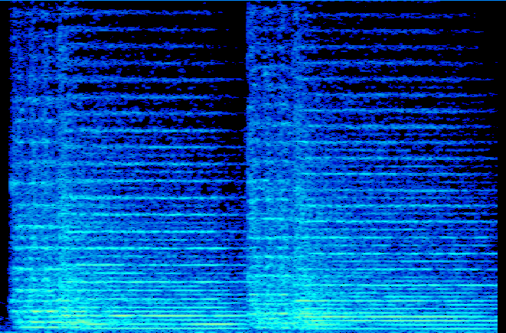
Notes:
Explanation of spectrogram goes here

Slide 4
Overview
History of Web Audio
Sounds like…
Bits of Sound
Bits of Note
Off the Scale
Sound of Music
Notes:
On a high, broad level.

Slide 5
Incredibly Brief History of Audio
Early attempts using <bgsound> and <embed>
Allowed background music
Only supported in Internet Explorer / Netscape
Most modern sound done using Flash
Requires plugins
Standard Flash issues of proprietary software, limited devices
No standard for audio across browsers
Notes:
Sure many people will remember the feeling of having fingernails scratched across the chalkboard of their soul whenever a website burst a poor MIDI replication of a song at them in the middle of the night.

Slide 6
Incredibly Brief History of Audio
Emergence of the HTML5 standard
Audio included as part of it
Arguments with regards to formats persist
Limitations exist
Timing
Analysis
Generation
Notes:
What we needed was a full featured API that would allow us to work with sound instead of just triggering it

Slide 7
Incredibly Brief History of Audio
Mozilla created Audio Data API
Uses HTML5’s <audio /> tag
Extends capabilities with JavaScript
Has functionality now supported by Web Audio API
Deprecated in favour of it

Slide 8
Web Audio API
Previous technologies supported
Playing
Pausing
Resuming
Limited in terms of timing and power
Notes:
If that.

Slide 9
Web Audio API
The Web Audio API
High-level JavaScript library
Abstracts away from low-level details
Allows for sounds to be analysed and synthesized
Uses an audio context comprised of various audio nodes
Notes:
If that.

Slide 10
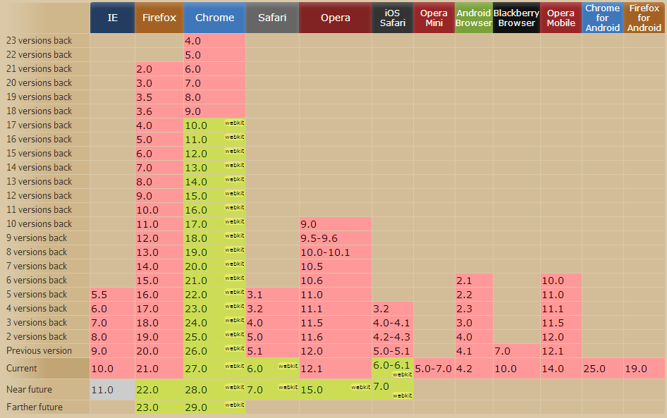
Web Audio API
http://caniuse.com/audio-api
Notes:
Here the red shows no support, yellow is partial support, blue is support unknown – obviously it’s an evolving standard so full support is very difficult.

Slide 11



Audio Contexts
Source
Destination
Notes:
The idea behind audio contexts is that we can have sound flowing between various audio nodes on a directed graph. For example, in the most basic case, we can have sound flowing directly from a source to a destination. The source could be a file, or another audio node that is passing sound on or that is generating completely new sound.

Slide 12


Audio Contexts
Source
Gain Node
Destination
Notes:
The beauty of these contexts is that the nodes can be combined in any way, much like a physical sound setup. For example, we could insert a gain node and increase the amplitude of the sound.

Slide 13

Audio Contexts
Gain Node
Source
Destination
Delay Node
Notes:
We can go a couple of steps further, splitting the input sound into two nodes, increasing the gain of the one and delaying the other by fraction of a second. These are almost easier to express in code than to illustrate, so let’s have a look at some code samples.

Slide 14
Audio Contexts
As the Web Audio API has only partial support, we need to be careful when acquiring an audio context.
The audio context is used as the base for all of our operations.
Only one audio context exists at any time.

Slide 15
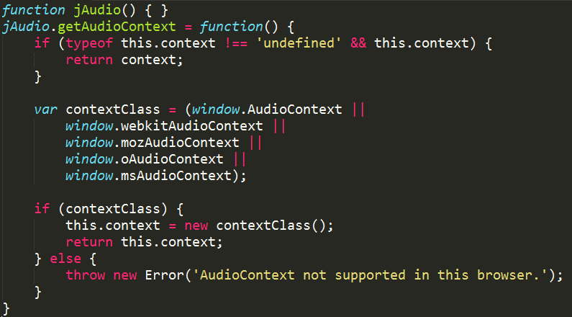
Audio Context
Notes:
Once we have a context, creating and linking audio nodes together is as easy as creating and linking audio nodes together.

Slide 16
Audio Nodes
Once a context is created, nodes can be created using it and then linked to one another.
A special node, context,destination, exists as the node which leads to the speakers. Any audio directed to this node will be played.
Assume we already have an ArrayBuffer named soundBuffer loaded.

Slide 17
Audio Nodes
Source
Destination
Notes:
To recap, what we’re after is a source node, connected directly to a destination.

Slide 18
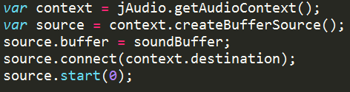
Audio Nodes
Source
Destination
Notes:
We use the context to create a buffer source node. All audio nodes are created in this way.

Slide 19
Audio Nodes
Various nodes are available
Source Nodes
Modification Nodes
Analysis Nodes
Destination Nodes
Notes:
Source nodesSound sources such as audio buffers, live audio inputs, <audio> tags, oscillators, and JS processors
Modification nodesFilters, convolvers, panners, JS processors, etc.
Analysis nodesAnalyzers and JS processors
Destination nodesAudio outputs and offline processing buffers

Slide 20
Audio Nodes
We’re going to focus on generating entirely new sounds
This will require use of the script processor node, which allows us to specify the contents of its output using JavaScript
But first, what is sound anyways?

Slide 21
Sounds like…
The physical component of sound is a pressure wave
A pressure wave is a wave of high and low pressures travelling through the air
These are sensed by our eardrums and converted into signals our brains understand

Slide 22
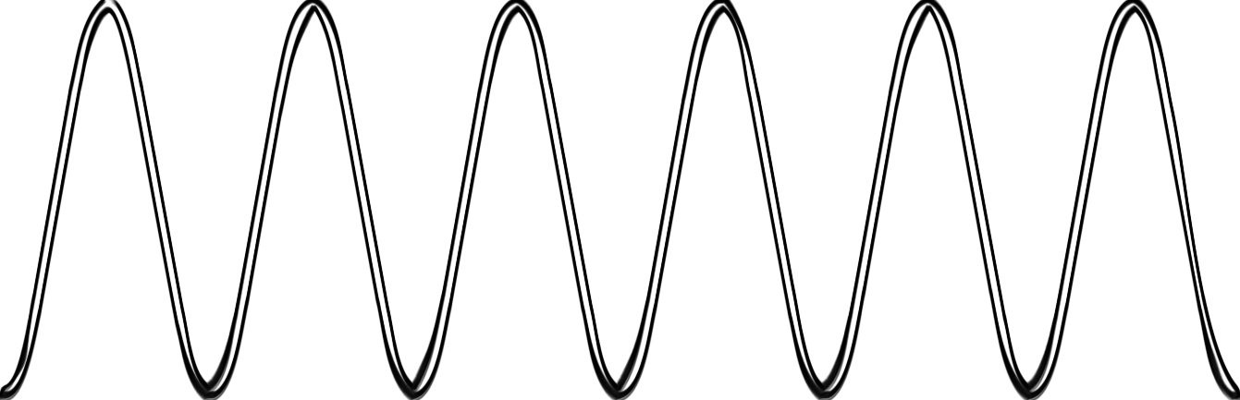
Sounds like…
Notes:
This band of moving pressure strikes our ear drums. Various properties of the band affect how we hear it.

Slide 23
Sounds like…
Time (ms)
Notes:
This can also be viewed as a graph of a wave against time. This is obvious, but important.

Slide 24
Sounds like…
Notes:
The amplitude of the wave is the amount that it changes between its highest and lowest parts. A higher amplitude affects how loud the sound is.

Slide 25
Sounds like…
Notes:
The more frequently the wave repeats, the higher we perceive the note to be. We call this the frequency of the note. Obviously, computers work discretely and so we cannot represent these continuous waves in them. Instead,

Slide 26
Sounds like… sampling
Notes:
To extract a representation of sound from a wave, we sample it. That is, we take points and record the value at those points. The number of points that we record over the course of a second is known as the sample rate. The number of bits that we use to represent a bar is known as the bit rate. As these increase, our approximation of the original sound will improve. For example, a CD has 44 100 measures a second (44.1 kHz) with 16-bit audio (having of course 65536 as its maximum)
There’s another common concept that has both amplitude and frequency and allows us to sample it at any point -

Slide 27
Sounds like… sampling
Original Sampling, 44.1kHz
Resampling to 22.050 kHz
Resampling to 8 kHz
Notes:
Here we have our original piece, resampled into two different sample rates.
Sampling picture on click.

Slide 28
Sounds like… sampling
Notes:
In our original diagram, even though it itself is at low sample rate, you can see the rough matching of samples to the sound. If we reduce the sample rate, the width of each sample will increase

Slide 29
Sounds like… sampling
Notes:
Obviously this diagram is exaggerated slightly to make the effects easier to see, but basically we lose resolution in the sound. But how is this getting us closer to generating new sounds? Well, we know of another concept that has frequency, amplitude and allows us to sample at points.

Slide 30

Sounds like…
$$f\left(x\right)=sin⁡(x)$$
Notes:
Sine waves have amplitudes and frequencies inherently. Obviously, substituting x in allows us to sample it at any point along the wave. We can use sine waves to synthesize sounds instead of having to sample existing audio. Most implementations of sine have a range between 0 and 2 pi – using this, we can restate this equation in terms of the frequency, sample rate and amplitude that we’ve been working with.

Slide 31

Sounds like…
$$frequency=\frac{sample rate}{cycle length}$$
Notes:
The frequency of a sample can be calculated as the sample rate divided by the length of the wave cycle.

Slide 32

Sounds like…
$$frequency=\frac{sample rate}{2π}$$
Notes:
In our case the wave length is 2 pi

Slide 33
Sounds like…
$$f\left(x\right)=sin⁡(x)$$
Notes:
If we were generating sounds with a sine wave directly, we would generate sounds at a frequency proportional to the sample rate. This is because every time we called the function, the function would advance. To gain some control over the frequency instead, we can divide by the sample rate divided by Pi, and times by the frequency.

Slide 34
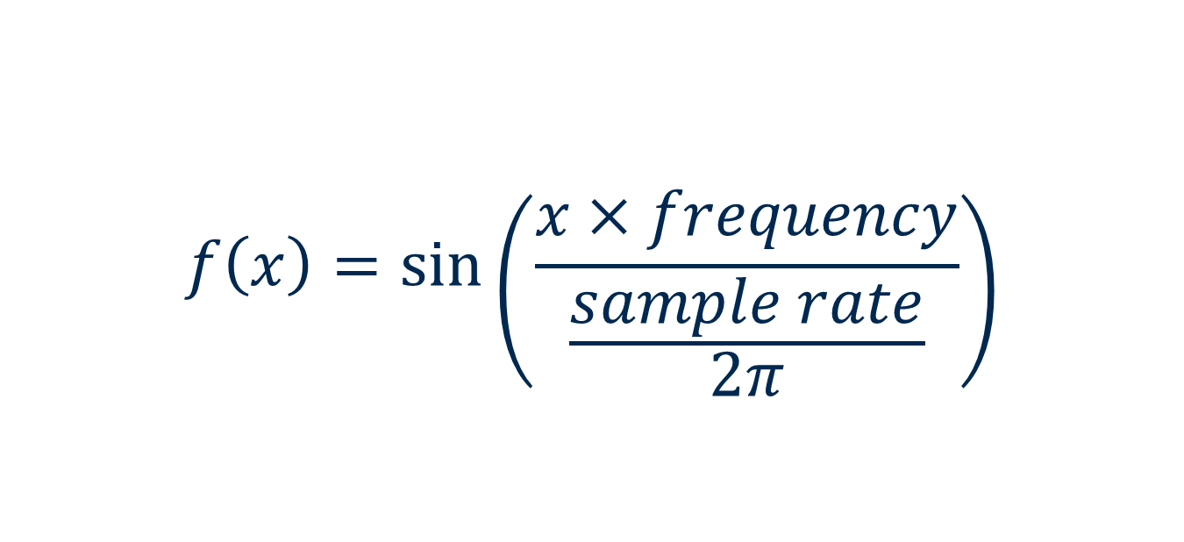
Sounds like…
$$f\left(x\right)=sin⁡\left(\frac{x×frequency}{\frac{sample rate}{2π}}\right)$$
Notes:
If we were generating sounds with a sine wave directly, we would generate sounds at a frequency proportional to the sample rate. This is because every time we called the function, the function would advance. To gain some control over the frequency instead, we can divide by the sample rate divided by Pi, and times by the frequency. We can clean up this equation slightly..

Slide 35

Sounds like…
$$f\left(x\right)=sin⁡\left(\frac{2πx×frequency}{sample rate}\right)$$
Notes:
We cannot vary the sample rate, but we can now vary the frequency. If we add one more component to specify amplitude – that is, the height of the waves…

Slide 36
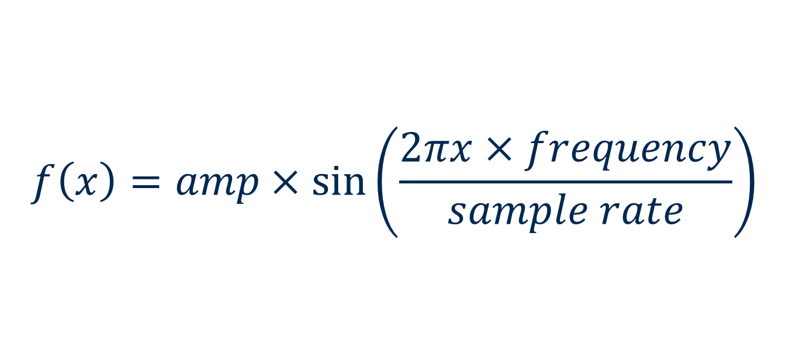
Sounds like…
$$f\left(x\right)=amp×sin⁡\left(\frac{2πx×frequency}{sample rate}\right)$$
Notes:
We can now generate a sine wave for a given amplitude and frequency. That’s pretty much a multi-platinum album right there. Well, let’s do it.

Slide 37
Bits of Sound
We’re going to use the JavaScriptNode
This node triggers JavaScript when it is reached in the audio graph
It can analyse the data coming via the input, trigger actions, modify the data, or generate entirely new data.
Notes:
We’re going with the third choice obviously. We could have started with this node right at the beginning, but without our new-found sound-fu the results would be fairly dismaying. Not that our initial results are going to be particularly pleasing.

Slide 38
Bits of Sound
First we’ll use the context to create a JavaScriptNode
We’ll need the sample rate for our calculations
Need to set up some defaults
Notes:
The JavaScriptNoce takes three input parameters – the buffer size, number of input nodes and the number of output nodes.

Slide 39
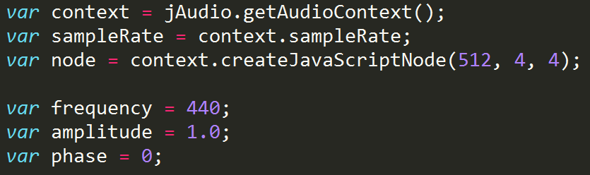
Bits of Sound
Notes:
By default we’re setting our frequency to 440 hz, for reasons which will be made clearer later.

Slide 40
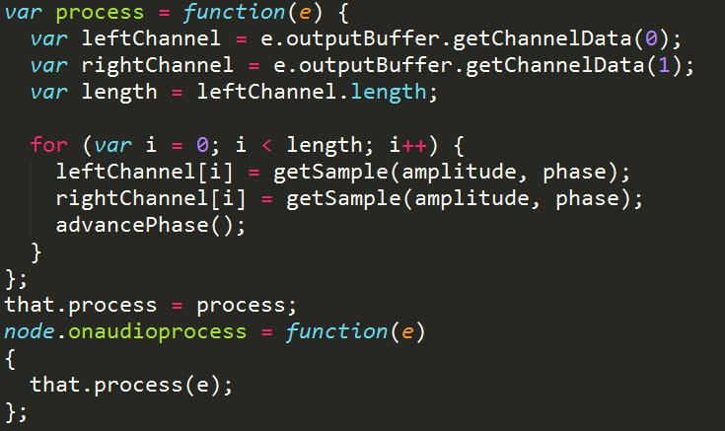
Bits of Sound
Notes:
The JavaScriptNode has an onaudioprocess event. This is processed whenever the audio graph reaches the javascript node. It is passed the current output buffer with the various channels in it – we could modify or analyse this data, but we’re going to generate new data instead. You’ll notice we only iterate up to the size of the output buffer. This window is specified in the constructor - image

Slide 41
Bits of Sound
buffer size
Notes:
Although we could generate the entire wave at the beginning, this could cause a startup delay and would prevent us from being able to make changes. Instead, as the node is called whenever it needs to provide data, we just generate data for our current window.
As the window moves along, the section that we are generating for moves along. For our sine wave, we increment our x appropriately.

Slide 42

Bits of Sound
Notes:
We also have a function to generate the sample corresponding to the position in the current window. This is almost the sine formula we saw before. This is given in terms of the phase – the phase is our current position in the sine wave cycle. As a full sine wave cycle takes up 2 pi, values between 0 and 1 will cover the entire range.

Slide 43
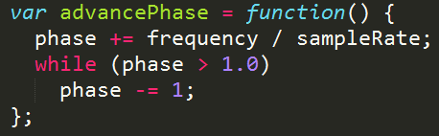
Bits of Sound
Notes:
Breaking up the equation in this way so that the amount that the phase is incremented is dependent on the frequency means that we do not get clicks in the audio caused by the sudden change in frequency.

Slide 44
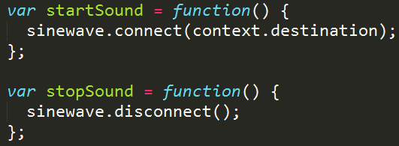
Bits of Sound
Notes:
Finally, we have a start sound and a stop sound function. These are bound to buttons that let us start and stop the sound. I’ve also included a frequency slider as well as an amplitude slider to let us change the values.

Slide 45
Sounds like…
<insert mathematically sound, hence pleasing, demo here/>
Notes:
We can now generate a sine wave for a given amplitude and frequency. That’s pretty much a multi-platinum album right there. That being said, let’s have a listen to that.

Slide 46
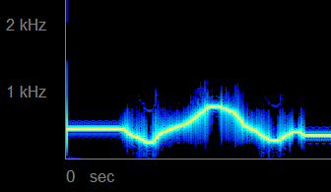
Sounds like…
Notes:
Visually, this is what it looks like.

Slide 47
Bits of Note
Noise has been achieved
We don’t particularly want to listen to it
No musical value

Slide 48
Bits of Note
A – B – C – D – E – F – G
Notes:
Musical notes are commonly divided up into 8 distinct full steps, beginning at one note and ending on the same note one octave higher. Moving an octave higher is equivalent to doubling the frequency of the note. The notes used are the first seven letters of the alphabet – that is:
A complete octave for this would therefore … - A, where the final A is a single octave higher. There are four half steps as well, making for 12 steps in each octave. These four additional steps are placed as follows, in the traditional order starting at C.

Slide 49
Bits of Note
C – C# – D – Eb – E – F – F# – G – G# – A – Bb – B
Notes:
A scientific notation exists for this, to allow for notes spanning octaves, where we use the name of the note as well as the octave. Generally, notes are given with A4,

Slide 50
Bits of Note
A4
=
440hz
Notes:
A scientific notation exists for this, to allow for notes spanning octaves, where we use the name of the note as well as the octave. Generally, notes are given with A4 being set at 440hz and the rest of the notes tuned relative to it. With this knowledge, and the knowledge that increasing by an octave doubles the frequency and that there are 12 equally set steps in the octave, we can calculate the frequency for each note as

Slide 51

Bits of Note
$$f_{n}=f_{0}×a^{n}$$
where
$$f_{0}=440hz, a=\sqrt[12]{2}, n=steps from A4$$
Notes:
F0 is commonly set to 440hz, but this is not a requirement. As an example, when we are 12 steps above A4 we have

Slide 52

Bits of Note
$$f_{n}=f_{0}×{\left(\sqrt[12]{2}\right)}^{12}$$
Notes:
Which is equal to

Slide 53

Bits of Note
$$f_{n}=f_{0}×2$$
Notes:
And so we’ve double our frequency going up one octave

Slide 54

Bits of Note
$$f_{n}=f_{0}×a^{n}$$
where
$$f_{0}=440hz, a=\sqrt[12]{2}, n=steps from A4$$
Notes:
Inverting this calculation allows us to get a formula for calculating the number of half-steps we are away from A4, given a frequency.

Slide 55

Bits of Note
$$n=\frac{\log{\frac{f_{n}}{f_{0}}}}{\log{a}}$$
where
$$f_{0}=440hz, a=\sqrt[12]{2},f_{n}=current frequency$$
Notes:
Okay, enough math. Let’s stick this in our demo and see if it becomes any more pleasing.

Slide 56
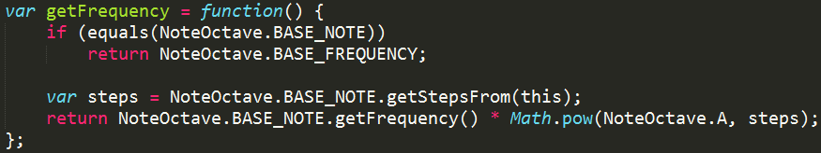
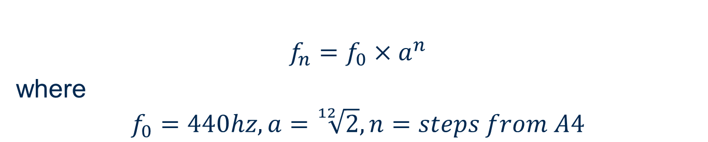
Bits of Note
$$f_{n}=f_{0}×a^{n}$$
where
$$f_{0}=440hz, a=\sqrt[12]{2}, n=steps from A4$$
Notes:
Making this change is fairly simple – we just need to restrict the range of frequencies that can be picked. Whenever a frequency is picked, we’ll convert it to its closest note and then convert back to a frequency to get the closest frequency. First, we need to be able to convert a note to a frequency. Next, we need the inverse.

Slide 57
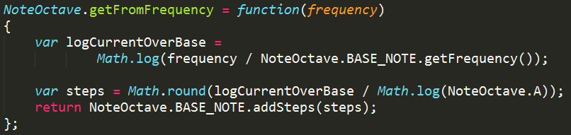

Bits of Note
$$n=\frac{\log{\frac{f_{n}}{f_{0}}}}{\log{a}}$$
where
$$f_{0}=440hz, a=\sqrt[12]{2},f_{n}=current frequency$$
Notes:
Now that we have these functions, with that crucial rounding pushing us to the closest note, we can modify the event where the frequency is set

Slide 58
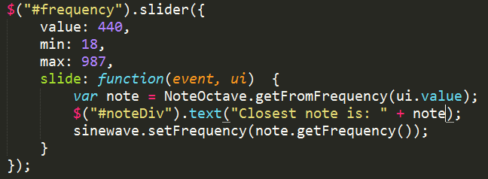
Bits of Note
Notes:
Now that we’ve gotten rid of the jarring notes, we can have another listen.

Slide 59
Sounds like…
<insert slightly more musically sound, hence pleasing, demo here/>
Notes:
So – jarring notes gone, but still lacking that musical touch. Let’s have a look at a tiny bit more theory – then we’ll know everything

Slide 60
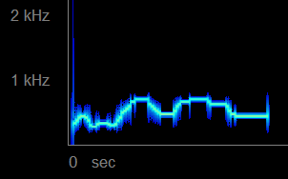
Sounds like…
Notes:
So – jarring notes gone, but still lacking that musical touch. Let’s have a look at a tiny bit more theory – then we’ll know everything

Slide 61
Sounds like…
Notes:
For comparison, here are the two side by side.

Slide 62
Off the Scale
Scale is a series of musical notes ordered by pitch
Musical pieces are commonly built using the notes of a single scale
Scales generally span an octave
They are generated by moving up certain amounts of steps
Notes:
We’re just going to focus on one scale here, the Pentatonic. Mostly because that gives me a chance to show Bobby McFerrin playing with it at the World Science Festival – video is in the slides notes if you’d like to see something amazing: http://www.youtube.com/watch?v=ne6tB2KiZuk

Slide 63
Off the Scale
Pentatonic scale created by shifting:
Base | 2 | 2 | 3 | 2 | 3
Notes:
The numbers here are given in half-steps. To create a pentatonic scale, say starting from A,

Slide 64
Off the Scale
Pentatonic scale created by shifting:
Base | 2 | 2 | 3 | 2 | 3
A
Notes:
We first shift up two half-steps, so one whole step. That gives us a B

Slide 65
Off the Scale
Pentatonic scale created by shifting:
Base | 2 | 2 | 3 | 2 | 3
A | B
Notes:
See? Told ya. We then move up another two, then three, then two.

Slide 66
Off the Scale
Pentatonic scale created by shifting:
Base | 2 | 2 | 3 | 2 | 3
A | B | C# | E | F#
Notes:
Finally, another three steps brings us one octave higher and back to A. There is no set exact formula for scales, they’re simply what various cultures find to be pleasing.

Slide 67
Off the Scale
Pentatonic scale created by shifting:
Base | 2 | 2 | 3 | 2 | 3
A | B | C# | E | F# | A
Notes:
Finally, another three steps brings us one octave higher and back to A. There is no set exact formula for scales, they’re simply what various cultures find to be pleasing. To generate our scales, we need to be able to add steps to an existing note.

Slide 68
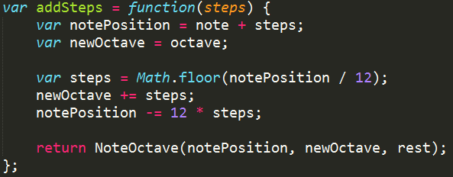
Off the Scale
Notes:
Calculating the note steps and octave up from the existing note steps and octave is fairly easy. After we’ve done that, we simply start from an existing note and move up the required number of steps until we have the entire scale.

Slide 69
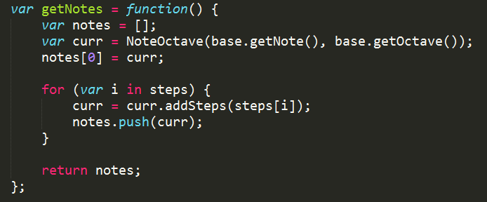
Off the Scale
Notes:
This is part of a larger object named Scale. Here we just look through the values of the steps loaded in scale and generate a note for each of them by adding steps using our previous function.

Slide 70

Off the Scale
Notes:
I have a couple of scales loaded – as you can see, we just specify the number of halfsteps to increase by each time. I also added some code to change the current note after a half second has passed.

Slide 71
Off the Scale
<insert scaled up demo here/>
Notes:
That’s much better actually – we almost have a semblance of music.

Slide 72
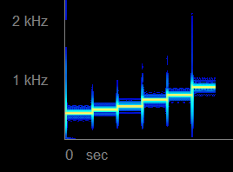
Off the Scale
Notes:
Having a look at the spectrogram for this, we can see the clear lines where we’ve generated the corresponding frequencies

Slide 73
Sounds like…
Notes:
Here’s the set of sounds we’ve generated up until now.

Slide 74
Sound of Music
Able to generate new sounds at desired frequencies in semi-musical way
One final trick up our sleeves

Slide 75
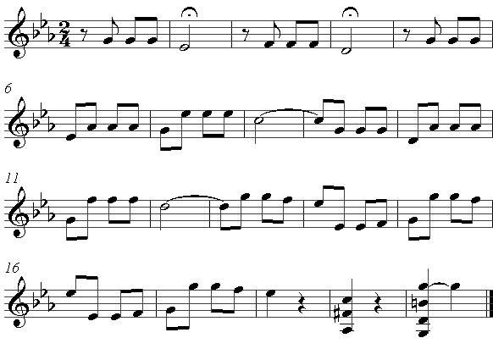
Sound of Music

Slide 76
Sound of Music
Standard music is difficult for machines to parse
Allows for wide range for expression but a cost of complexity
Another type of musical notation exists that is more suited to parsing
Notes:
You could say it’s extremely generic

Slide 77
Sound of Music
e--3-3-3-----------1-1-1--------------------------------------------------------
B--------44--------------33-------------------------------4-4-4-1---------------
G--0-0-0----------------------------------0-0-0---1-1-1-0---------------0-0-0---
D--------11--------3-3-3-00---------------------1-----------------------------0-
A-------------------------------------------------------------------------------
E-------------------------------------------------------------------------------
Notes:
Guitar tab was designed for those without the inclination to learn the more complex musical theory – in its basic form, it presents us with base notes, and steps along them where you should pick notes.
In short, it’s almost identical to the data structure we have – just six of them overlaid on one another.

Slide 78
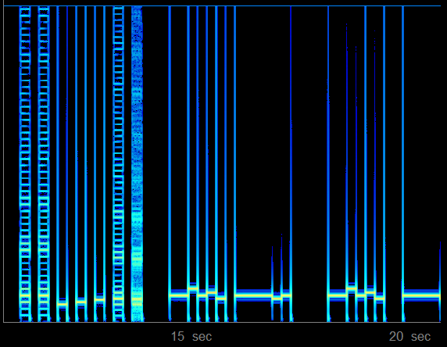
Sound of Music

Slide 79
Conclusion
The Web Audio API has emerged as a strong alternative to Flash and is gaining in popularity
Audio contexts and audio graphs make it easy to combine nodes to generate audio effects
JavaScriptNodes allow us to manipulate data as we wish
Notes:
OscillatorNode does exist – unless you have spent ages writing a new version for a presentation, you’ll probably want to use it instead. This was an example of the powerful things we can do with just JavaScriptNode – OscillatorNode has this and more built in for you.

